Slide 1
CSCI-4320/6360: Parallel Programming & Computing DCC 308, Tues./Fri. 10-11:30 a.m. Introduction, Syllabus & Prelims
Prof. Chris Carothers
Computer Science Department
MRC 309a
Office Hrs: Tues/Fri, 11:30 a.m. – 1:30 p.m.
chris.carothers@gmail.com chrisc@cs.rpi.edu
www.cs.rpi.edu/~chrisc/COURSES/PARALLEL/SPRING-2018

Slide 2
Let’s Look at the Syllabus…
See the syllabus on the course webpage.

Slide 3
To Make A Fast Parallel Computer You Need a Faster Serial Computer…well sorta…
Review of…
Instructions…
Instruction processing..
Put it together…why the heck do we care about or need a parallel computer?
i.e., they are really cool pieces of technology, but can they really do anything useful beside compute Pi to a few billion more digits…

Slide 4
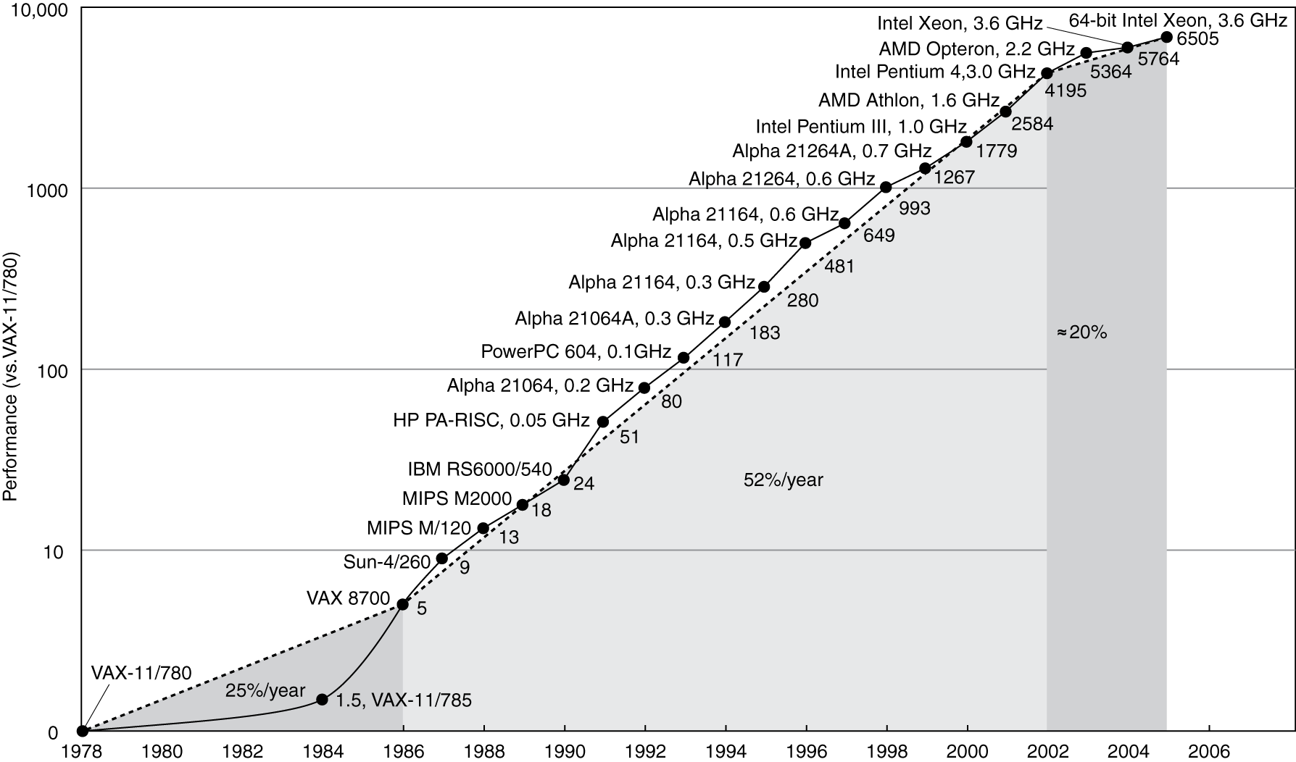
Single Processor/Core Performance Over Time
From: “Computer Organization and Design: The Hardware/Software Interface”, Patterson and Hennessy, 2009
Processor clock rates and overall performance peaked in ~2005! Why?

Slide 5
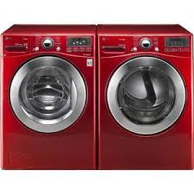
“Laundry” Processor Design
Processor functions similar to doing laundry.
Sort the clothes
Wash a load of clothes
Dry a load of clothes
Fold a load of clothes
Place clothes in cabinet
Processors operate on “instructions” instead of clothes
E.g add two numbers and store result
Can do better than serial processing of steps!

Slide 6
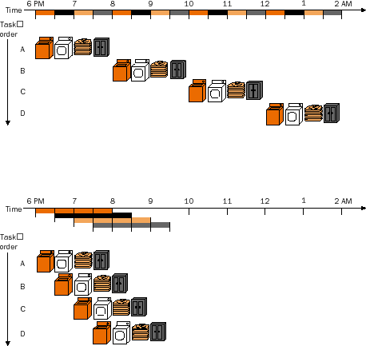
Pipeline “Laundry” Processing
From: “Computer Organization and Design: The Hardware/Software Interface”,
Patterson and Hennessy, 2009
Overlaps each step so you are done by 9:30 p.m. and not 2 a.m. !
Can do even better if 2+ washers and dryers are used ..

Slide 7
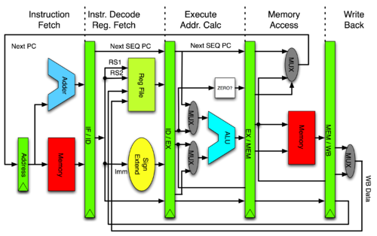
Pipeline Processor Design
Fetch
Decode
Execute
Memory Access
Write result back
All stages of the pipeline are overlapped which vastly improves performance!
“Superscalar” pipelines issue and processor multiple instructions per clock cycle.

Slide 8
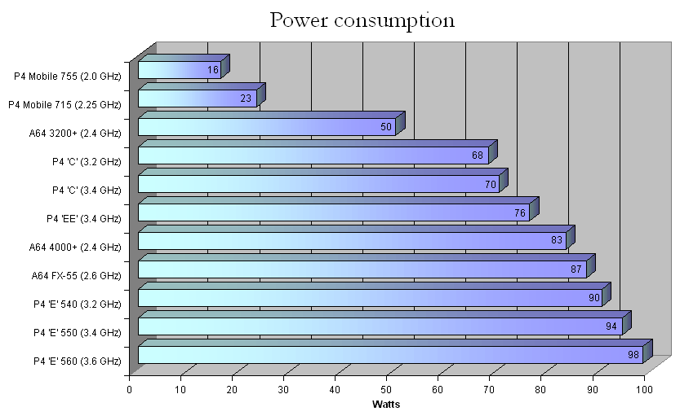
CPU Power Consumption…
Typically, 100 watts is the limit..

Slide 9
Single Processor/Core Performance Revisited
Exhausted instruction level parallelism (ILP), hit power wall and could not increase clock rate
Increased core count as new design point!
Golden age: Compiler + Architecture Innovations coupled with Moore’s Law

Slide 10
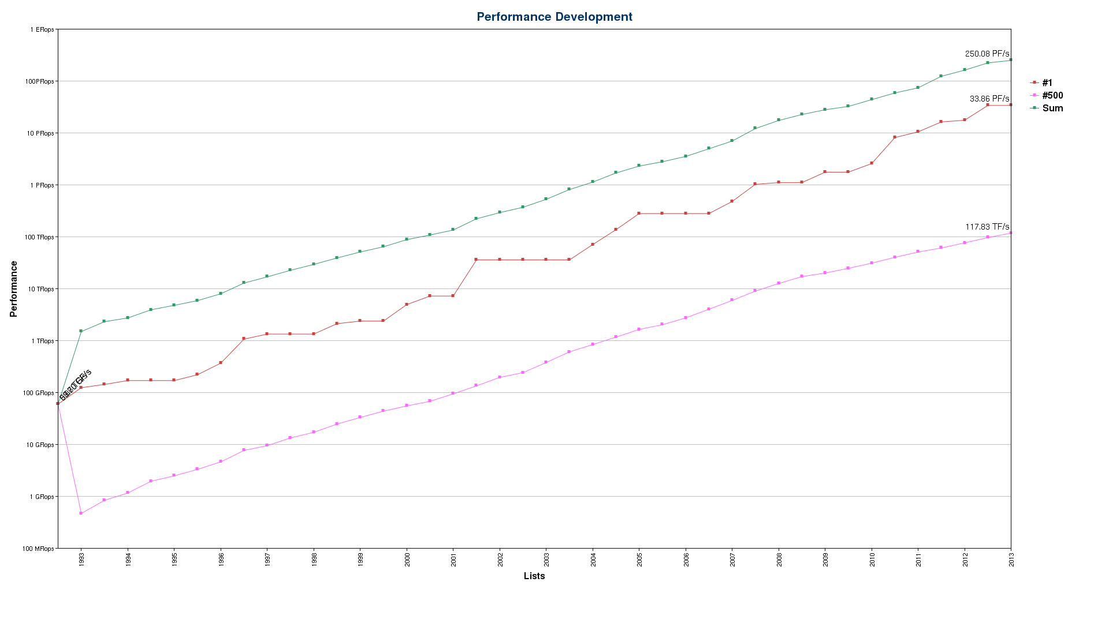
Impact of Multicore on Supercomputers…
In 2013, AMOS @ 1 PF: #1 private academic institution in US, #4 among all US universities,
Jan. 2018, AMOS is #229 but still #1 among US private institutions
11/2013: #1 system is ~287x faster than #500
50% of total performance is achieved by top 17 of the Top 500 systems
06/2007: #1 system is ~70x faster than #500
Top 500 list over time(1993 – 2013): Green is Sum, Red is #1, Pink is #500
Notes:
Say what Top500 list is.

Slide 11
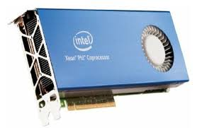
Multicores on Steroids: Accelerator and GPU cards
 | NVIDIA V100
Peak 64 bit FLOP rate | 7.8 TF
Memory Size | 16 GB
Memory Bandwidth | 900 GB/sec.
# of cores | 5,120
 | Intel Phi
Peak 64 bit FLOP rate | 1.2 TF
Memory Size | 16 GB
Memory Bandwidth | 352 GB/sec.
# of cores | 61
Intel Phi’s programming model is similar to AMOS.
The GPU (V100) execution model is a radical departure! Let’s see ➔

Slide 12
Simple CPU Implementation of Reduce Operation
/* integer specific reduce on CPU */
int reduceCPU(int *data, int size)
{
int sum = data[0];
for (int i = 1; i < size; i++)
{
sum += data[i];
}
return sum;
}
data[]
17
23
8
19
62
12
sum
141

Slide 13
NVIDA “CUDA” Implementation of Reduce Operation
template <unsigned int blockSize>
__global__ void reduce6(int *g_idata, int *g_odata, unsigned int n)
{
extern __shared__ int sdata[];
unsigned int tid = threadIdx.x;
unsigned int i = blockIdx.x*(blockSize*2) + tid;
unsigned int gridSize = blockSize*2*gridDim.x;
sdata[tid] = 0;
while (i < n) { sdata[tid] += g_idata[i] + g_idata[i+blockSize]; i += gridSize; }
__syncthreads();
if (blockSize >= 512) { if (tid < 256) { sdata[tid] += sdata[tid + 256]; } __syncthreads(); }
if (blockSize >= 256) { if (tid < 128) { sdata[tid] += sdata[tid + 128]; } __syncthreads(); }
if (blockSize >= 128) { if (tid < 64) { sdata[tid] += sdata[tid + 64]; } __syncthreads(); }
if (tid < 32) {
if (blockSize >= 64) sdata[tid] += sdata[tid + 32];
if (blockSize >= 32) sdata[tid] += sdata[tid + 16];
if (blockSize >= 16) sdata[tid] += sdata[tid + 8];
if (blockSize >= 8) sdata[tid] += sdata[tid + 4];
if (blockSize >= 4) sdata[tid] += sdata[tid + 2];
if (blockSize >= 2) sdata[tid] += sdata[tid + 1];
}
if (tid == 0) g_odata[blockIdx.x] = sdata[0];
}
~10x more complex to develop for 2-5x gain in performance.
// int specific reduce on CPU
int reduceCPU(int *data, int size)
{
int sum = data[0];
for (int i = 1; i < size; i++)
{
sum += data[i];
}
return sum;
}

Slide 14
“AMOS”/MPI Implementation of Reduce Operation
int reduceAMOS(int *data, int size)
{
int sum = data[0];
int final_sum = 0;
MPI_Allreduce( &sum,
&final_sim,
size,
MPI_INT,
MPI_SUM,
MPI_COMM_WORLD );
return final_sum;
}
data[]
17
23
8
19
62
12
sum
141
“task”
T0
T1
…
TN
All “sum”s
Reduce in Network
final_sum
T0
T1
…
TN
Notes:
Explain MPI task model first!!

Slide 15
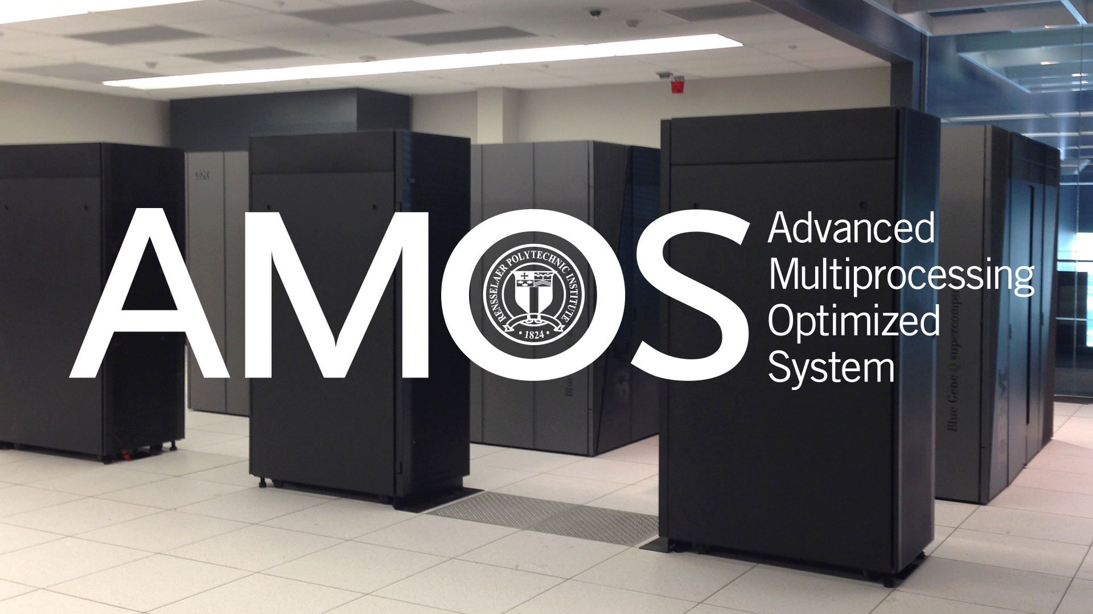

Supercomputers vs. Clouds
Supercomputer Systems:
Fault tolerance via well designed hardware & “checkpointing” of state by app.
Network: 20 GB/sec and < 5 usec latency
Massive parallel filesystem
Very power efficient system overall!!
Job scaling to millions of cores!
Custom network (e.g., BG/Q 5-D torus)
COTS “Cloud” Systems:
Fault tolerance via replication of data via software - Hadoop/MapReduce
Network: 1 to 5 GB/sec and ~500usec latency
Client disks used like extended RAM memory which drives cloud design and performance
Less power efficient system
Job scaling limits to < 1,000 cores
Commodity network (e.g., 1 Gb/sec Ethernet switch)
Notes:
Giga == billions, Tera == trillions, Peta = Quadrillions and Exa == Sextillions

Slide 16
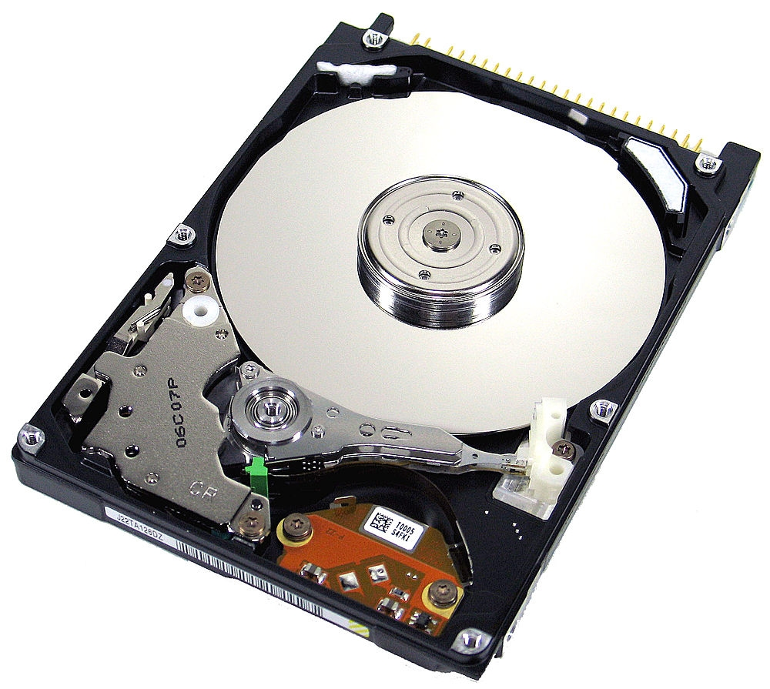
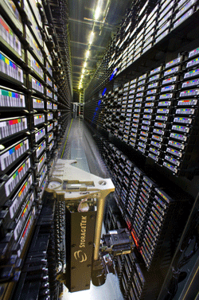
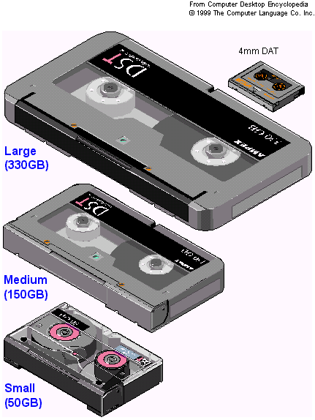
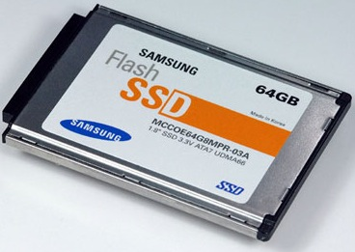
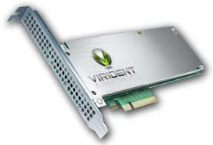
What About Storage Devices?
LTO 6
2.5 TB, 160 MB/sec
Spindle
Platter
Head
Actuator
Magnetic Hard Disk Drives
Magnetic Tape
Semi-conductor storage w/o any moving parts!
Solid State Storage (SSD) / NVMe
Thanks to R. Ross, ANL and B. Welch, Google
Notes:
Question: Why do we use tape? LTO == Linear Tape-Open which is an open standard developed in the 1990’s

Slide 17
Disk Transfer Rates over Time
7.4 hours to read 4 TB SATA
At 150 MB/sec
25 minutes to read 440 GB disk
At 280 MB/sec (Cheetah @ 15K RPM)
5 minutes to read 315 MB disk
At 1 MB/sec (IBM 3350)
Large growing cap between storage and compute!!
Thanks to R. Freitas of IBM Almaden Research Center for providing much of the data for this graph.
Notes:
17

Slide 18
Why can’t we move to FLASH ?
Storage Hierarchy is DRAM, SCM, FLASH, Disk, Tape
Cannot manufacture enough bits via Wafers vs. Disks
SSD 10x per-bit cost, and the gap isn’t closing
Cost of semiconductor FAB is >> cost of disk manufacturing facility
World-wide manufacturing capacity of semi-conductor bits is perhaps 1% the capacity of making magnetic bits
500 Million disks/year (2012 est) avg 1TB => 500 Exabytes (all manufacturers)
30,000 wafers/month (micron), 4TB/wafer => 1.4 Exabytes (micron)
And Tape doesn’t go away, either
Still half the per-bit cost, and much less lifetime cost
Tape is just different no power at rest physical mobility higher per-device bandwidth (1.5x to 2x)
Thanks to R. Ross, ANL and B. Welch, Google

Slide 19
Amdahl’s Law
The anti-matter to Moore’s Law..(cpu performance doubles every 24 months)
Actually it is more about transistor counts…
The law states that given N processors and F is the faction of execution time that can be made parallel, then the amount of performance improvement (i.e., speedup) is:
1/((1 – F) + F/N)
Note as N → infinity, then speedup limited by
1/(1-F)
So, then what about supercomputers ….

Slide 20
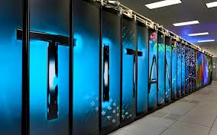
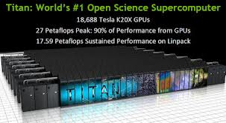
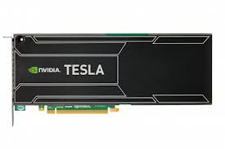
Titan - #5 on Top500 @ 27/17.49 PF
Architecture 18,688 AMD Opteron 6274 16-core CPUs +
18,688 Nvidia Telsa K20X GPUs
Power 8.2 MW
Space 404 m² (4352 ft²)
Memory 710 TB (598 TB CPU and 112 TB GPU)
Storage 10 PB, 240 GB/sec peak data rate
Speed 17.59 PF @ Linpack)
27 petaFLOPS theoretical peak
Cost US$97 million

Slide 21
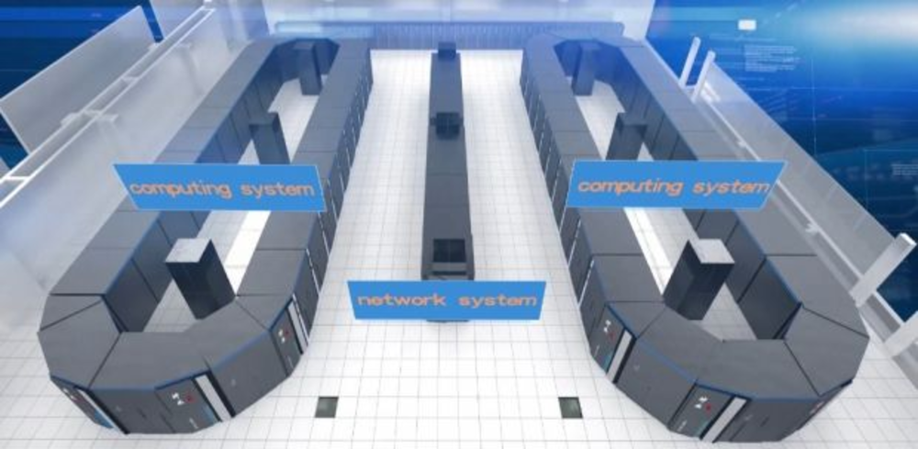
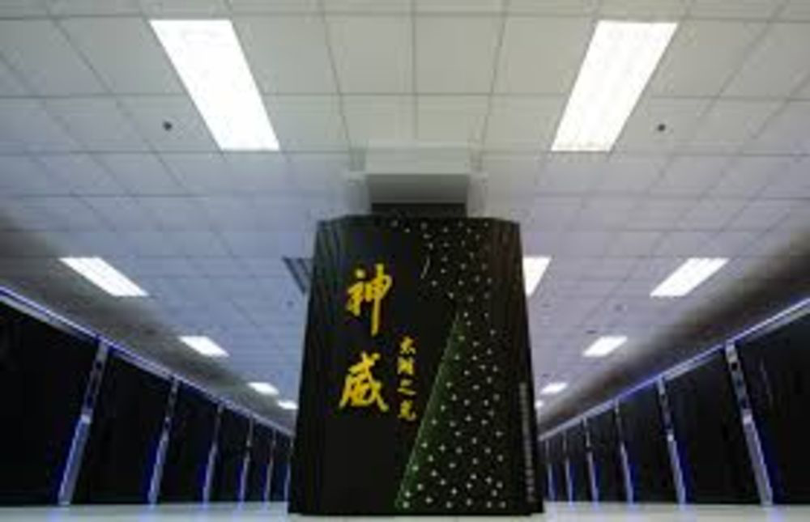
Sunway TaihuLight - #1 @ 125/93 PF
Site: Nat. SC Center in Wuxi
Manufacturer: NRCPC
Cores: 10,649,600
Linpack Performance (Rmax) 93,014.6 TFlop/s
Theoretical Peak (Rpeak) 125,436 TFlop/s
Nmax 12,288,000
Power: 15,371.00 kW (Submitted)
Memory: 1,310,720 GB
Processor: Sunway SW26010 260C 1.45GHz
Interconnect: Sunway
Operating System: Sunway RaiseOS 2.0.5

Slide 22
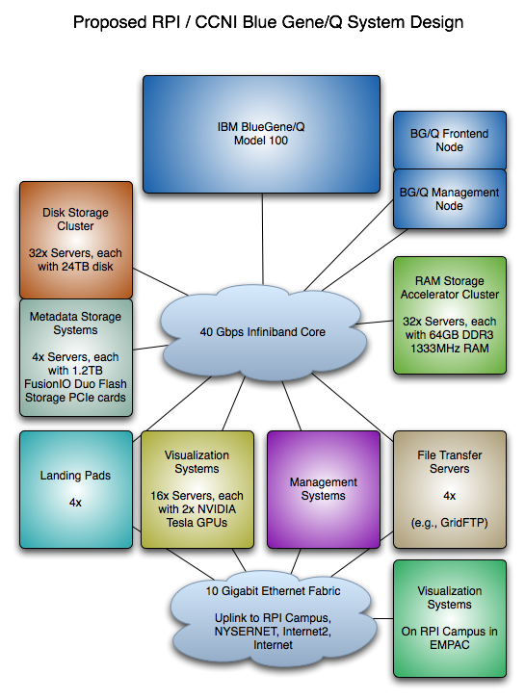
AMOS “Balanced” Cyberinstrument @ CCI
Blue Gene/Q
~1 PF peak @ 2+ GF/watt
81,920 cores
80 TB RAM
More bandwidth than 1 million
home ISP
Data Center Network
IB FDR Switch
324 ports @ 56 Gbit/sec each
Disk storage
IBM Elastic Storage
2 petabytes raw
Bandwidth: 10 to 20 GB/sec
X86 clusters
RSA: 34 nodes, 8 Xeon cores, 256GB RAM
DRP: 64 nodes, 16 Xeon cores, 128GB RAM

Slide 23
“Summit” DCS Supercomputer

Slide 24
Disruptive Exascale Challenges…
1 billion-way parallelism
Cost budget of O($200M) and O(20M watts)
Note: 1M watt per year == $1 million US dollars
Power
500 pJ/op using Blue Gene/Q data
Need 20 pJ/op ( ~50 GF/watt) to meet 20 Mwatt power ceiling
Dominated by data movement & overhead
Programmability
Writing an efficient parallel program is hard!
Locality required for efficiency
System complexity is BARRIER to programmability

Slide 25
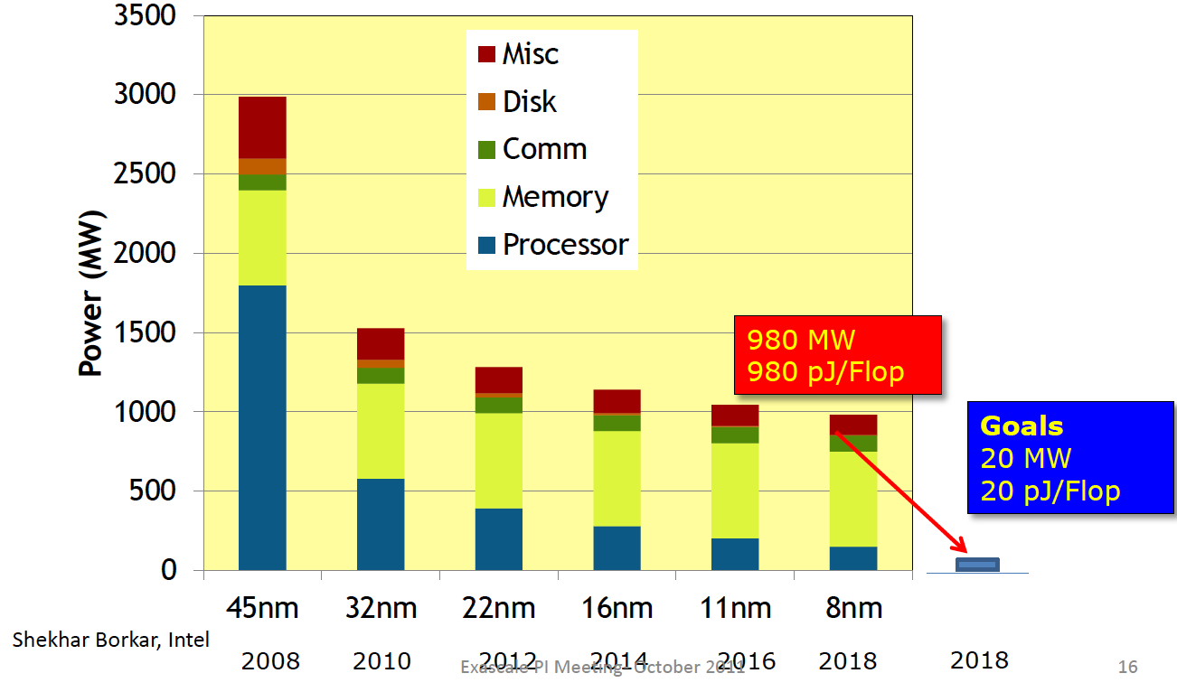
Power Drives Radically New Hardware and Software
Compute is FREE, cost is moving data
All software will have to be radically redesigned to be locality aware
Bill Dally – All CS complexity theory will need to be re-done!
Note: IBM Blue Gene/Q @ 45 nm!!

Slide 26
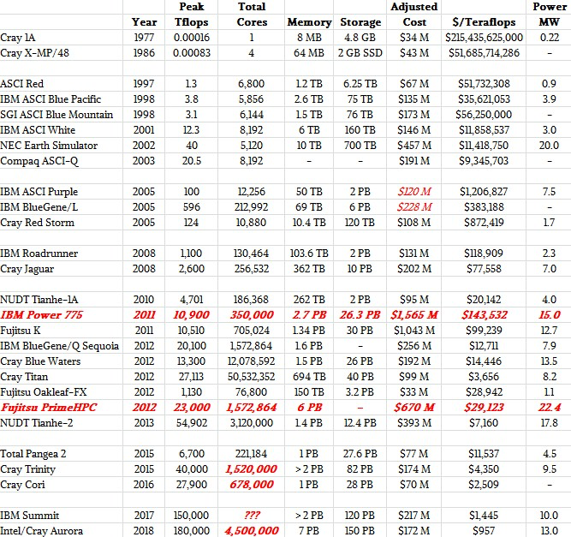
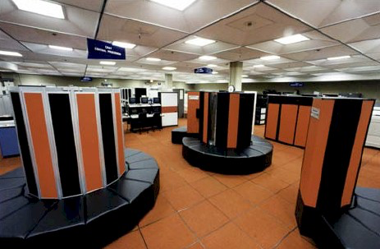
History of Supercomputer Power & Price
Source: The Platform.Net
⬅ 20x larger version of AMOS
Notes:
http://www.theplatform.net/wp-content/uploads/2015/04/hpc-over-time-table-3.jpg

Slide 27

What are SC’s used for??
Can you say “fever for the flavor”..
Yes, Pringles used an SC to model airflow of chips as the entered “The Can”..
https://www.hpcwire.com/2006/05/05/high_performance_potato_chips/
Improved overall yield of “good” chips in “The Can” and less chips on the floor…
P&G has also used SCs to improve other products like: Tide, Pampers, Dawn, Downy and Mr. Clean

Slide 28
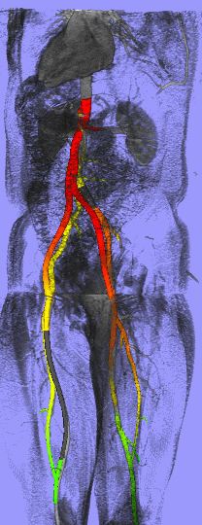
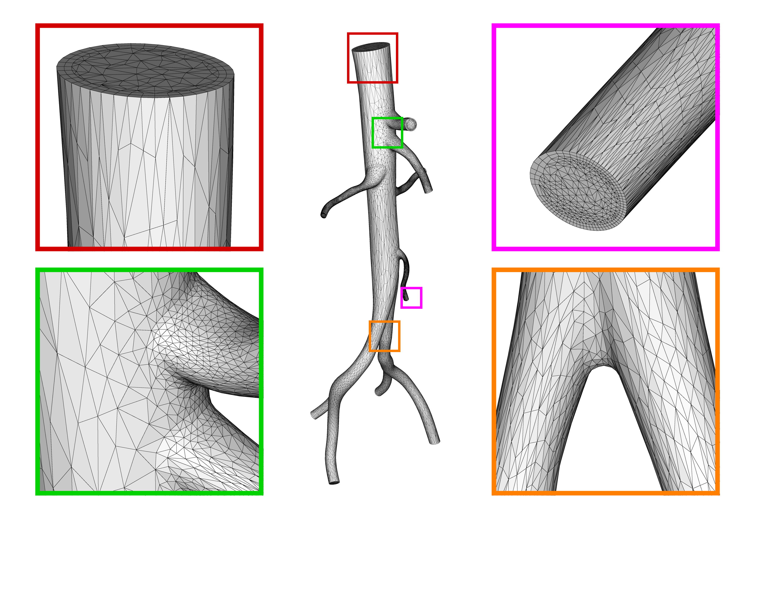
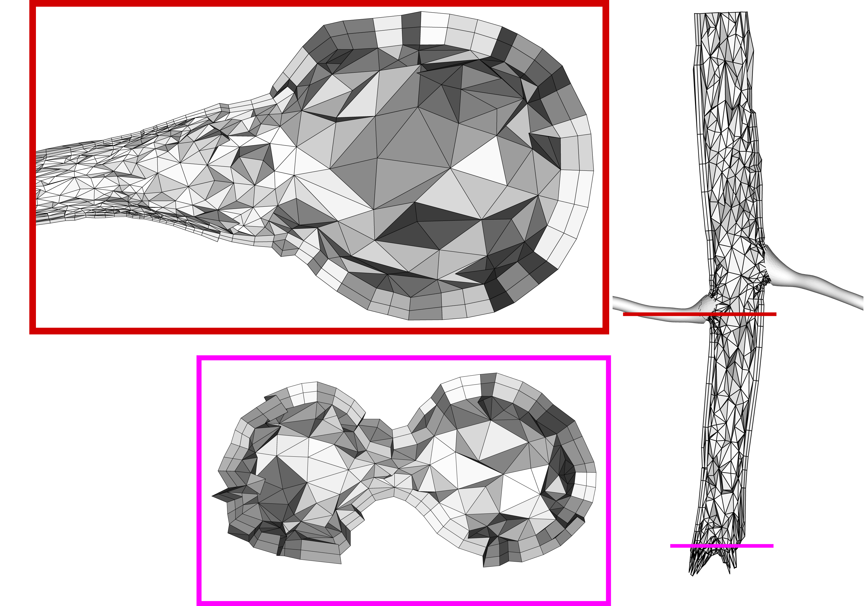

Patient Specific Vascular Surgical Planning
Virtual flow facility for patient specific surgical planning
High quality patient specific flow simulations needed quickly
Simulation on massively parallel computers
Cost only $600 in ‘09 on 32K Blue Gene/L vs. $50K for a repeat open heart surgery…
At exascale this will cost more like 6 cents!
Notes:
28
Added reference to Simmetrix

Slide 29

Operation “White Frost” from 2008
Notes:
Planning done on Cray XT3, Red Storm. Dedicated time for 2 month. Used mix of ensemble and hero runs.

Slide 30

Disruptive Opportunities @ 2^60
A radical new way to think about science and engineering
Extreme time compression on very large-scale complex applications
Materials, Drug Discovery, Finance, Defense, and Disaster Planning & Recovery…
Technology enabler for …
Smartphone “supercomputers” w/ 25 GFlop and 100’s GB RAM
Petascale “supercomputer” in all major universities @ $200K
IBM Watson – AI/DL “desk-side” edition
Home users have 100 GB network and Terascale+ “home” supercomputers…
Exascale Neuromorphic procesors!!!

